Slide 1

Paint your own Decoration
Krzysztof Krasiński-Sroka
Cross-Platform Mobile Development Summit 2020
Notes:
Here are my notes

Slide 2

Krzysztof Krasiński-Sroka Owner/Tech Lead at Widgeters
Full-Stack Programmer
Public Speaker
Community Organizer
Flutter GDE
Entrepreneur

Slide 3


Slide 4
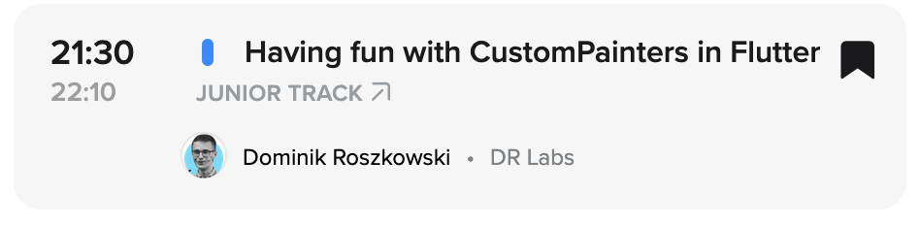
Dominik’s talk some hours ago

Slide 5
What are Decorations?

Slide 6
What are Decorations?
Decoration is not a Widget 😱

Slide 7
What are Decorations?
Decoration is… something that can be painted in front of or behind a Widget

Slide 8
What are Decorations?
Flutter provides: BoxDecoration ShapeDecoration UnderlineTabDecoration FlutterLogoDecoration

Slide 9
What to do with Decoration?
Put them in Container or DecoratedBox

Slide 10
How to do a Decoration?
Show > Tell

Slide 11
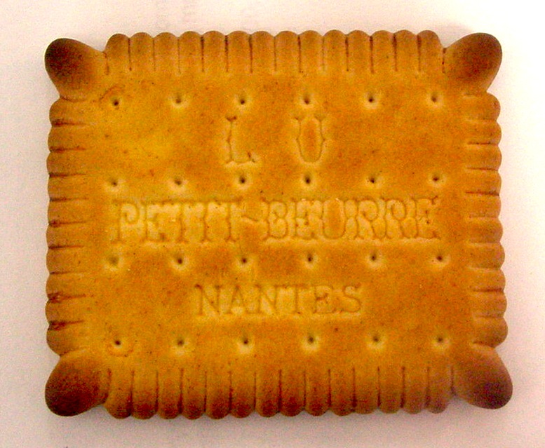
This Photo by Unknown Author is licensed under CC BY-SA

Slide 12
Thanks!

